Slide 1
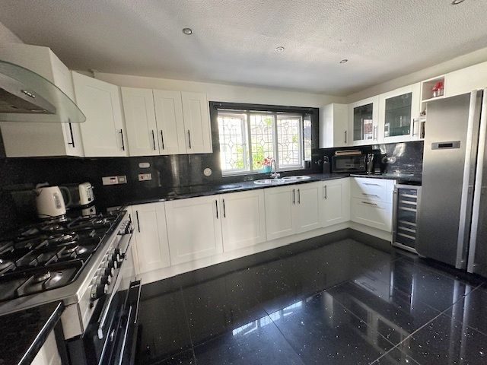
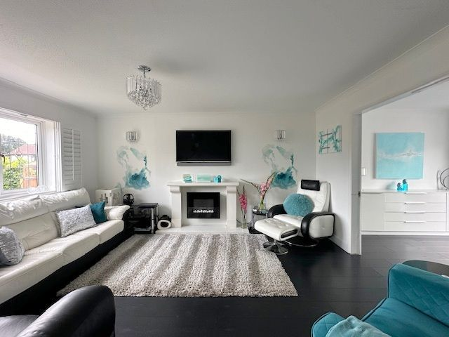
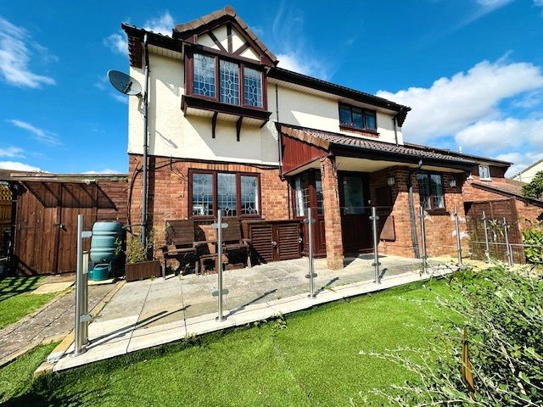
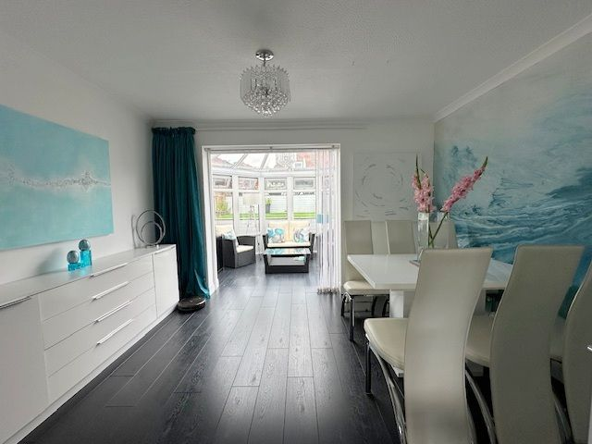
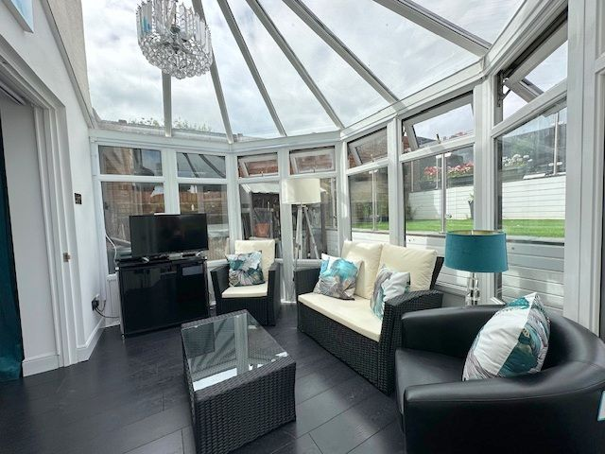
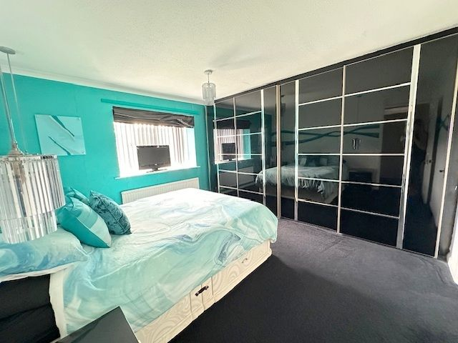
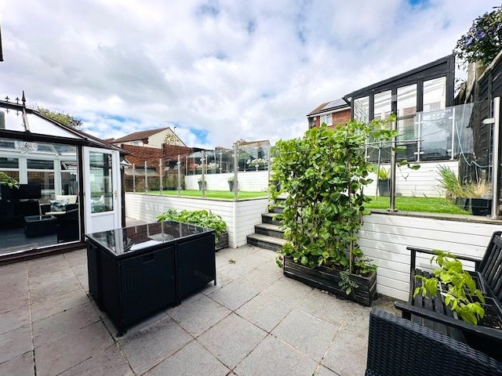
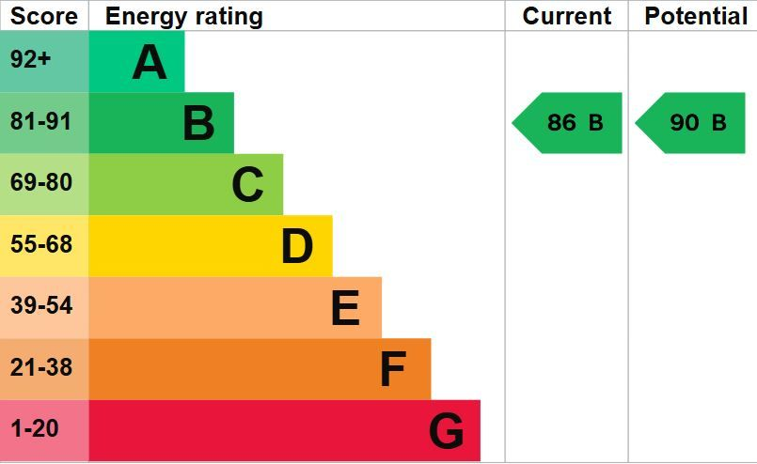
www.pennys.net
7 Norwich Close, Exmouth, EX8 5QW
GUIDE PRICE £575,000
TENURE Freehold
A Beautifully Presented Four Bedroom Detached Family Style Residence Situated In A Favoured Cul-De-Sac Location Enjoying Sunny Gardens To Front And Rear Aspects, Off-Road Parking & Double Garage
Covered Entrance Canopy & Reception Hall • Bright & Spacious Lounge & Separate Dining Room • Kitchen/Breakfast Room & Utility Room •
Conservatory With Patio Doors Opening Onto Rear Garden • Ground Floor Study/Office •
Ground Floor Cloakroom/WC • Four First Floor Bedrooms - Main With En-Suite Shower Room/WC • First Floor Family Bathroom/WC • Beautifully Presented Front & Rear Gardens • Driveway Parking & Detached Double Garage - Viewing Highly Recommended •
Pennys Estate Agents Limited for themselves and for the vendor of this property whose agents they are give notice that:- (1) These particulars do not constitute any part of an offer or a contract. (2) All statements contained in these particulars are made without responsibility on the part of Pennys Estate Agents Limited. (3) None of the statements contained in these particulars are to be relied upon as a statement or representation of fact. (4) Any intending purchaser must satisfy himself/herself by inspection or otherwise as to the correctness of each of the statements contained in these particulars. (5) The vendor does not make or give and neither do Pennys Estate Agents Limited nor any person in their employment has any authority to make or give any representation or warranty whatever in relation to this property.
PENNYS ESTATE AGENTS
2 Rolle House, Rolle Street, Exmouth, Devon, EX8 2SN
Tel: 01395 264111 EMail: help@pennys.net

Slide 2
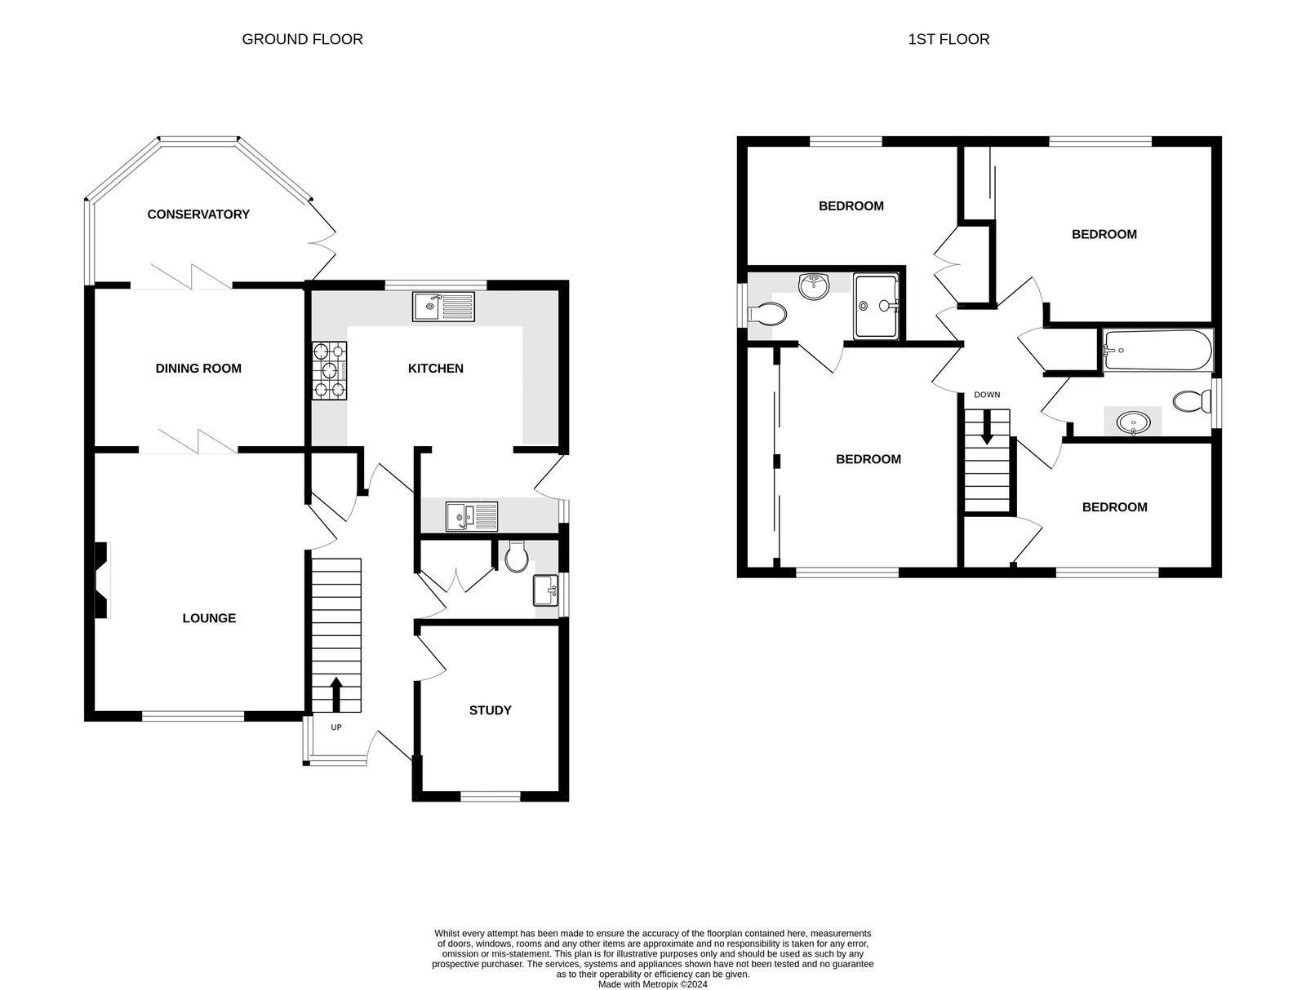
7 Norwich Close, Exmouth, EX8 5QW
THE ACCOMMODATION COMPRISES: Covered entrance canopy with uPVC double glazed front door with pattern inset and matching picture windows leading to: RECEPTION HALL: Laminate flooring; wall mounted electric consumer unit; radiator with glass cover; dado rail; smoke alarm; storage cupboard with shelving; bespoke staircase with glass balustrade leading to first floor landing; light dimmer switch; solid wood doors to: LOUNGE: 4.47m x 3.63m (14'8" x 11'11") A bright and spacious room with uPVC double glazed window to front aspect with fitted wooden shutters; laminate flooring; feature electric living flame effect fire set in stone hearth and stone mantel over; television point; light dimmer switch; attractive wall lights; radiator; coved ceiling; double wooden doors opening onto: DINING ROOM: 3.66m x 2.82m (12'0" x 9'3") Laminate flooring; thermostat control for central heating; upright radiator; coved ceiling; double wooden doors opening to: CONSERVATORY: 3.48m x 2.44m (11'5" x 8'0") uPVC double glazed windows overlooking the rear garden; uPVC double glazed patio doors opening onto GARDEN; laminate flooring; hanging light. KITCHEN/BREAKFAST ROOM: 4.29m x 3.61m (14'1" x 11'10") Fitted with pattern worktop surfaces with matching splashbacks; range of base cupboards and drawer units; stainless steel circular sink unit with chrome mixer tap and separate circular drainer; double width Belling electric cooker with 7 ring gas hob above and stainless steel chimney extractor hood over; space for double width fridge freezer; freestanding wine cooler; wall mounted cupboards - some with glass display insets; cupboard housing Glow-Worm boiler serving domestic hot water and gas central heating; carbon monoxide alarm; recess ceiling LED spotlights; uPVC double glazed window to rear aspect overlooking the garden; thermostat control for central heating; glitter porcelain tiles; opening to: UTILITY ROOM: 2.64m x 1.65m (8'8" x 5'5") Fitted with patterned worktop surface and matching splashback with inset one and a half bowl sink drainer unit with mixer tap; plumbing for an automatic washing machine beneath; space for dishwasher; integrated tumble dryer; wall mounted cupboards; ceiling LED spotlights; uPVC double glazed window to side aspect and uPVC double glazed door to OUTSIDE; heated towel rail; glitter porcelain tiles . STUDY: 2.95m x 2.46m (9'8" x 8'1") uPVC double glazed window to front aspect with fitted wooden shutters; laminate flooring; radiator; telephone point. GROUND FLOOR CLOAKROOM/WC: Comprising of WC with concealed cistern and push button flush; wash hand basin set in vanity unit with drawers beneath; upright radiator; uPVC double glazed window with obscure glass; double doors to cupboard with hanging rail and shelving.
FIRST FLOOR LANDING: Access to roof space; smoke alarm; ceiling LED spotlights; airing cupboard housing water tank with shelving; light dimmer switch; doors to: BEDROOM ONE: 3.84m x 3.05m (12'7" x 10'0") A spacious main bedroom with uPVC double glazed window to front aspect with deep window cill; radiator; full width fitted wardrobes with hanging rails and shelving; hanging lights; light dimmer switch; door to: EN-SUITE SHOWER ROOM/WC: Comprising of a double width shower cubicle with electric Briston shower; wet wall boards; wash hand basin set into vanity unit with mixer tap and cupboards below; WC with concealed cistern and push button flush; heated towel rail; ceiling LED spotlights; wall mounted mirror fronted cabinets; porcelain floor tiles; uPVC double glazed window to side aspect with obscure glass. BEDROOM TWO: 3.66m x 3.45m (12'0" x 11'4") Maximum overall measurement into door recess. uPVC double glazed window to rear aspect with fitted wooden shutters; radiator; coved ceiling; double wardrobe with hanging rail, shelving and cupboards above. BEDROOM THREE: 3.73m x 2.74m (12'3" x 9'0") uPVC double glazed window to rear aspect; radiator; coved ceiling; double wardrobe with mirror fronted sliding doors, hanging rail and shelving; light dimmer switch.
BEDROOM FOUR: 3.25m x 2.41m (10'8" x 7'11") uPVC double glazed window to front aspect; radiator; coved ceiling; cupboard over stairwell. FAMILY BATHROOM/WC: 2.21m x 2.18m (7'3" x 7'2") Maximum overall measurement. White suite comprising of bath with chrome taps, rainfall shower and glass shower splash screen; WC with push button flush; circular wash hand basin with chrome mixer tap set in bespoke glass display unit with fitted mirror over; attractive fully tiled walls with fitted mirror; porcelain floor tiles; ceiling LED spotlights; uPVC double glazed window to side aspect with obscure glass. OUTSIDE: The property is approached via a tarmac driveway providing off-road parking for numerous vehicles and access to DOUBLE GARAGE with outside light. A pedestrian pathway and steps leading to the front of the property and timber gate and patio pathway providing pedestrian access to the rear garden. The property benefits a corner plot with a large area laid to lawn with artificial grass, mature shrub and flower beds, side pedestrian gate giving access onto Bystock Road, large workshop/store with power and light connected, bespoke glass balustrade and outside courtesy light. The rear garden is a stunning feature to the property with a spacious patio terrace ideal for outside al-fresco dining and entertaining. Steps leading up to two tiers, one with artificial grass and one with laid to patio with glass balustrades and an outside summer house with power and light connected. A side pedestrian gate giving access onto Bystock Road and additional timber storage shed, outside tap and outside light. DOUBLE GARAGE: uPVC double glazed door with matching picture window and additional up and over garage door; power and light connected. AGENTS NOTE: The property benefits from solar panels which are owned outright and has a battery and inverter.
FLOOR PLAN:

